Slide 1
E-Commerce Report
By Rahma Muhamed Under the supervision of Eng. Seba Mustafa

Slide 2
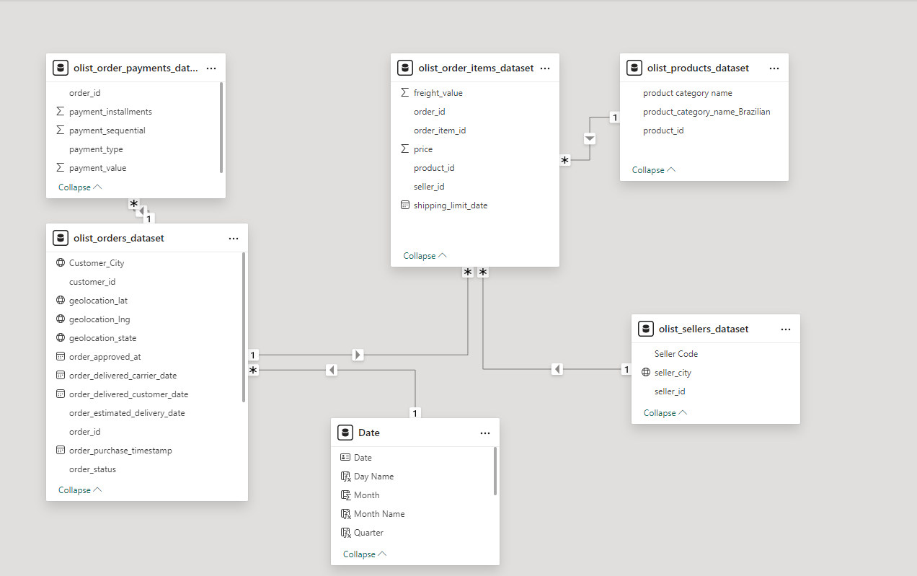
The data profile describes an online store in Brazil that began operations in late 2016. It appears that the store sells in various states and cities, and its sales seem to be increasing. I have cleaned and filtered this data, performed calculations, and developed this model, upon which I created the visualizations and derived insights.
I divided the data into categories: general data, product-specific data, seller-specific data, geographic location data, and time-specific data.
I formulated the business questions.
I then analyzed the data based on these categories and extracted insights.

Slide 3
Business Questions
What is the total revenue?
What is the total sales value?
What is the total number of units sold?
What is the total number of orders? Could you also provide a breakdown by order status?
What are the sales values per year?
What are the payment methods customers relied on, and what percentage of each method was used?
What are the top 10 products in terms of sales value?
What are the sales per product category? How many product categories do we have? How many units were sold in each category? And what is the relationship between sales amount and the number of units sold?

Slide 4
How many sales employees do we have? How many are in each state/city? Who are the top 10 employees in terms of sales percentage? And does the number of employees have any correlation with the sales percentage in each state?
How many states/cities do we sell to? Which of them has the highest sales value? And what are the top-selling categories in each?
What is the total sales and total orders per year?
What are the monthly sales? And what is the percentage change in sales every three months?
What is the average order delivery time in days? And what is the actual average delivery time?

Slide 5
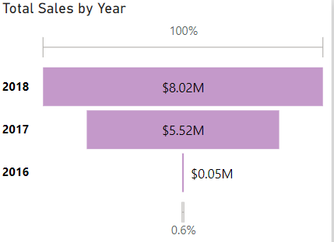
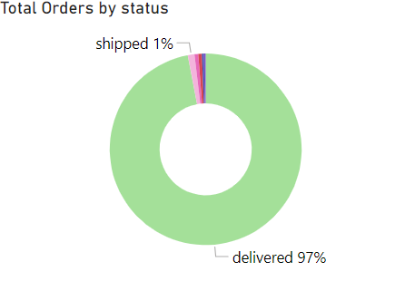
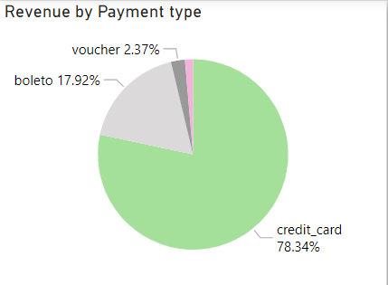
Business Insights
Sales in 2018 increased by 45.5% compared to 2017, and the number of orders also rose by 47.5%. This indicates that customers are satisfied with the company's products and that the customer base is expanding. It shows that these business efforts are successful.
It is evident that the percentage of completed orders delivered to customers is very high, at 97%, which is a positive indicator. However, we should not overlook the canceled orders and should investigate their causes to identify any potential issues.
Approximately 78% of customers choose to pay via credit card. This can be leveraged to the company’s advantage by forming partnerships with banks and relevant institutions, making it easier for customers and reducing collection costs for the company.

Slide 6
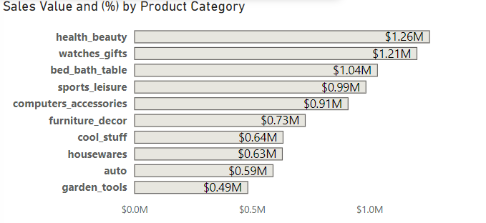
It is clear that customers are more interested in health and beauty products, which means there is an opportunity for the company to invest further in this area. Additionally, it is apparent that customers generally value luxury products, suggesting that the company has opportunities to expand its product categories to better align with customer interests.

Slide 7
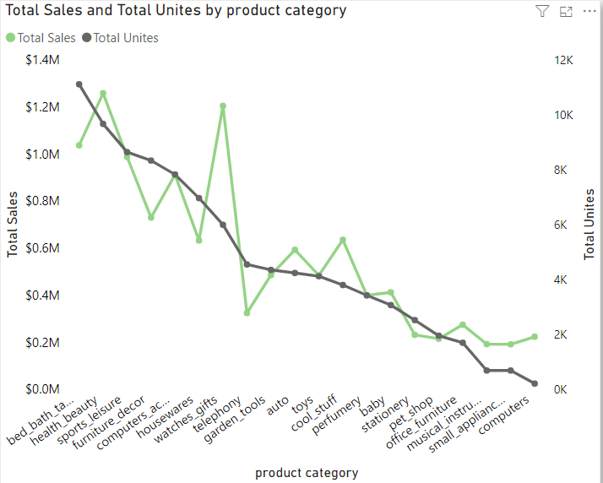
The chart shows that the increase in sales value is not related to the number of units sold, but rather to the type of products.

Slide 8
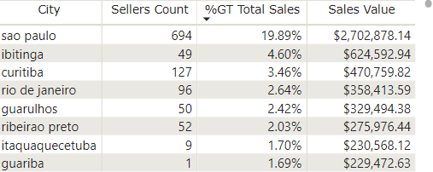
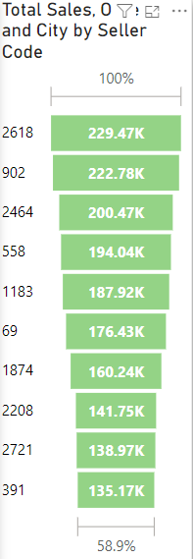
I suggest that the company consider increasing the number of sales representatives in cities with lower sales percentages. For instance, we observe that São Paulo has a significantly high number of sales representatives and also achieves the highest sales rate.
Additionally, we have identified the top 10 sales employees, and I recommend promoting them to train other less experienced sales representatives. This could ultimately increase sales for the company.

Slide 9
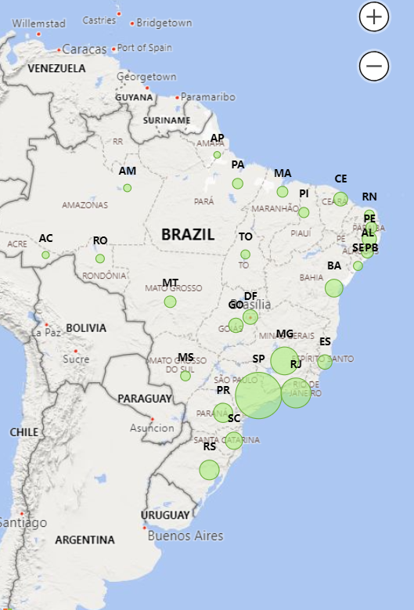
The map shows that the company has sales across various states and cities, but the sales values in these areas are not sufficient. I recommend that the company strengthen its presence in current cities with low sales rather than entering new markets.

Slide 10
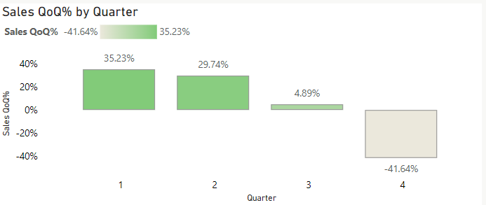
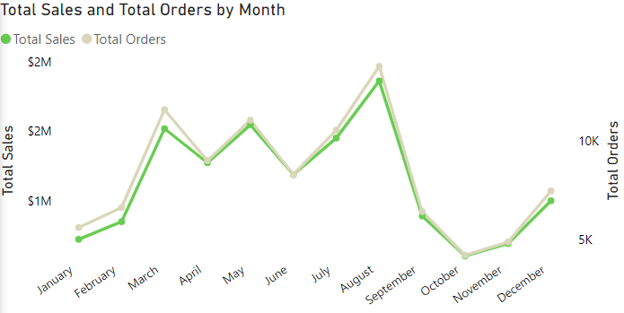
The average time taken to deliver orders to customers is almost half the expected average time, which indicates the efficiency of the delivery department.
It appears that purchase rates are very high in the first quarter of the year and gradually decrease toward the end of the year. This means that sales opportunities are stronger in the first half, so it's advisable to maximize them by providing the necessary types and quantities of products and following appropriate pricing strategies. Discounts and promotions should be reserved for the last quarter to attract customers.
Sales value is directly proportional to the number of orders during the year, so I recommend focusing on increasing the number of orders.

